Slide 1


K.RAMAKRISHNAN COLLEGE OF TECHNOLOGY (AUTONOMOUS), TRICHY
Splitting a Sales Dataset into
Monthly Subsets Using tidyr
PRESENTED BY
NEHA HENIN J – AM2325
GUIDED BY
Mrs.SANTHOSHINI, AP/AI

Slide 2
PRESENTATION OVERVIEW
Objective
Problem statement
Existing system and its drawback
Proposed system and it’s advantage
Block diagram
Dataflow Diagram
Module splitup
Module explanation
Screenshot
Conclusion

Slide 3
OBJECTIVE
To segment the sales dataset into monthly subsets using tidyr, enabling
    streamlined analysis and Improved data clarity

Slide 4
PROBLEM STATEMENT
The problem faced is sales data was combined in one file without clear separation
by month, making it hard to analyze or report on monthly performance.

Slide 5
EXISTING SYSTEM AND ITS DRAWBACK
Existing System:
All sales records are stored in a single dataset without monthly separation.
Drawback:
This makes it time-consuming to filter data, identify monthly trends, and
generate specific reports.

Slide 6
DATAFLOW DIAGRAM
user Interface (Shiny Frontend)
Question Database
(CSV / RDS File)
Server Logic
(ShinyBackend)
Score Calculation
Result Display

Slide 7
LIST OF MODULES
User Interface Module
Question Management Module
Answer Evaluation Module
Score Tracking Module
Feedback and Result Module
Data Storage Module
2/7/20

Slide 8
MODULES DESCRIPTION
USER INTERFACE MODULE – Builds the quiz layout and allows user interaction.
QUESTION MANAGEMENT MODULE – Loads and displays questions dynamically from data sources.
ANSWER EVALUATION MODULE – Compares user answers with correct ones to check accuracy

Slide 9
MODULES DESCRIPTION
SCORE TRACKING MODULE – Monitors and updates the user’s score during the quiz.
FEEDBACK AND RESULT MODULE – Provides instant feedback and shows final results.
DATA STORAGE MODULE – Handles storage of questions, answers, and user performance data.

Slide 10

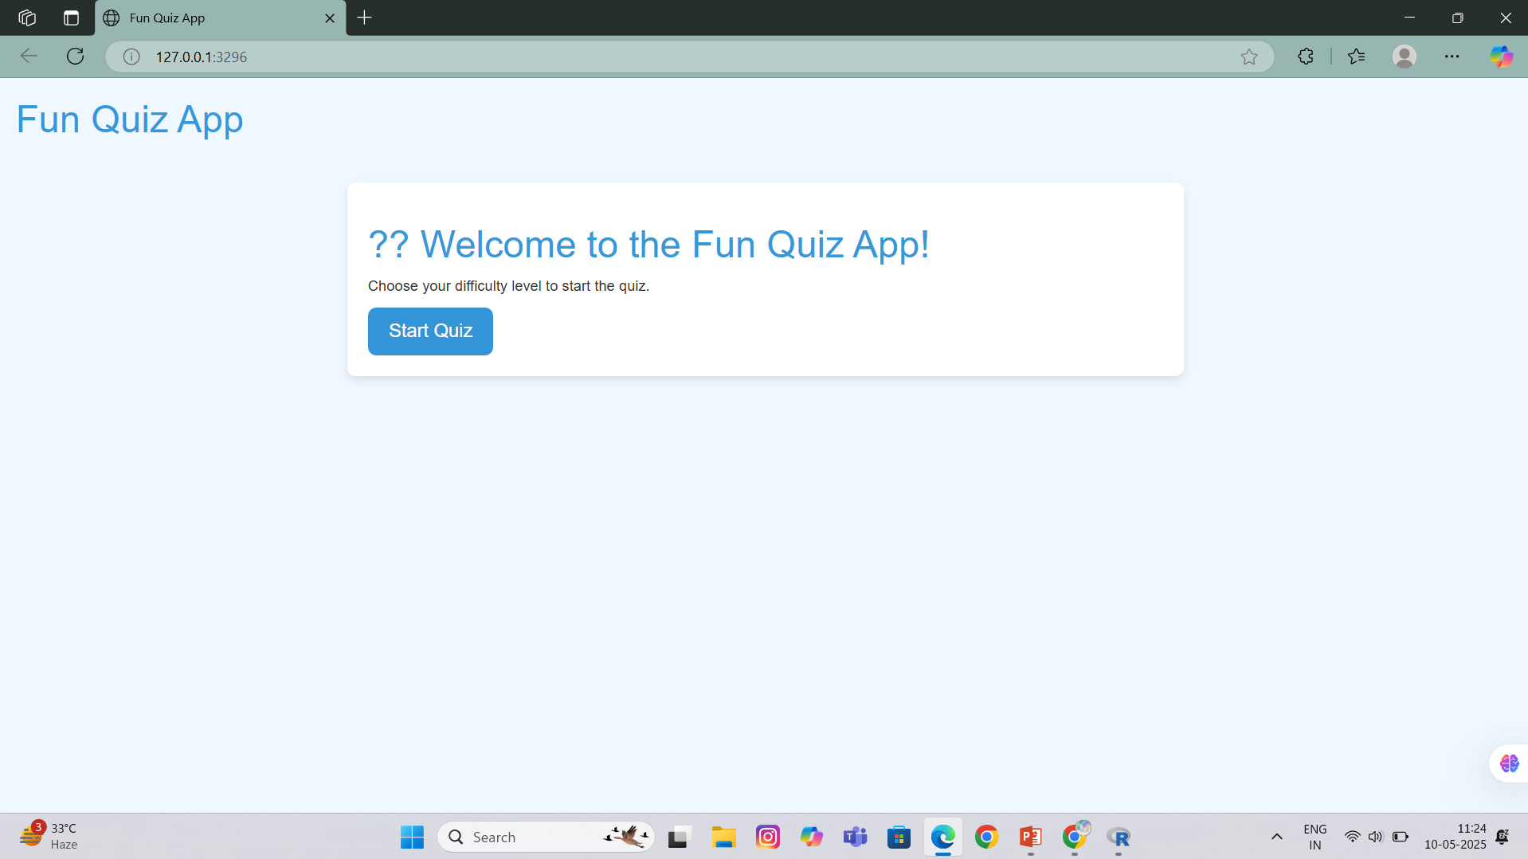
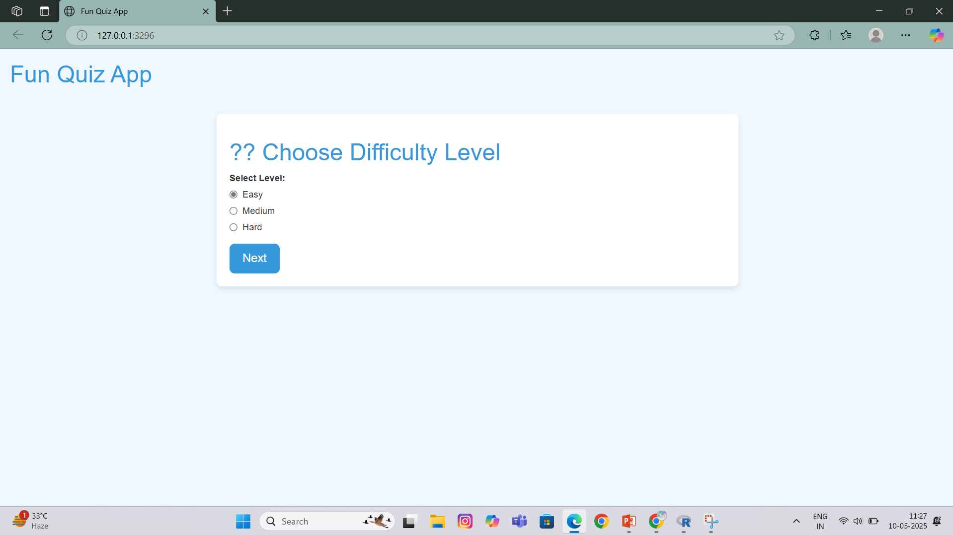

IMPLEMENTATION SCREENSHOTS

Slide 11


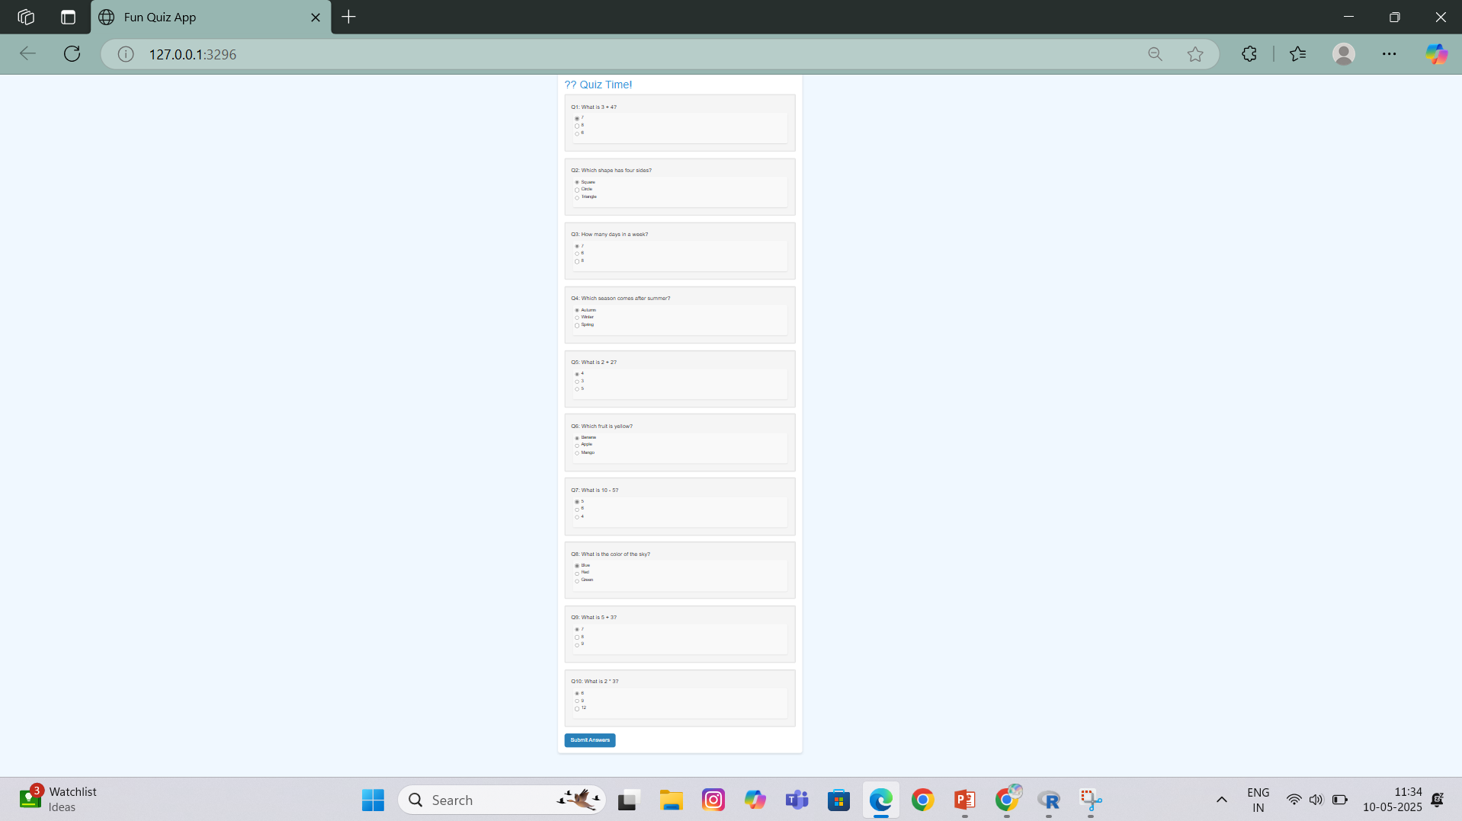
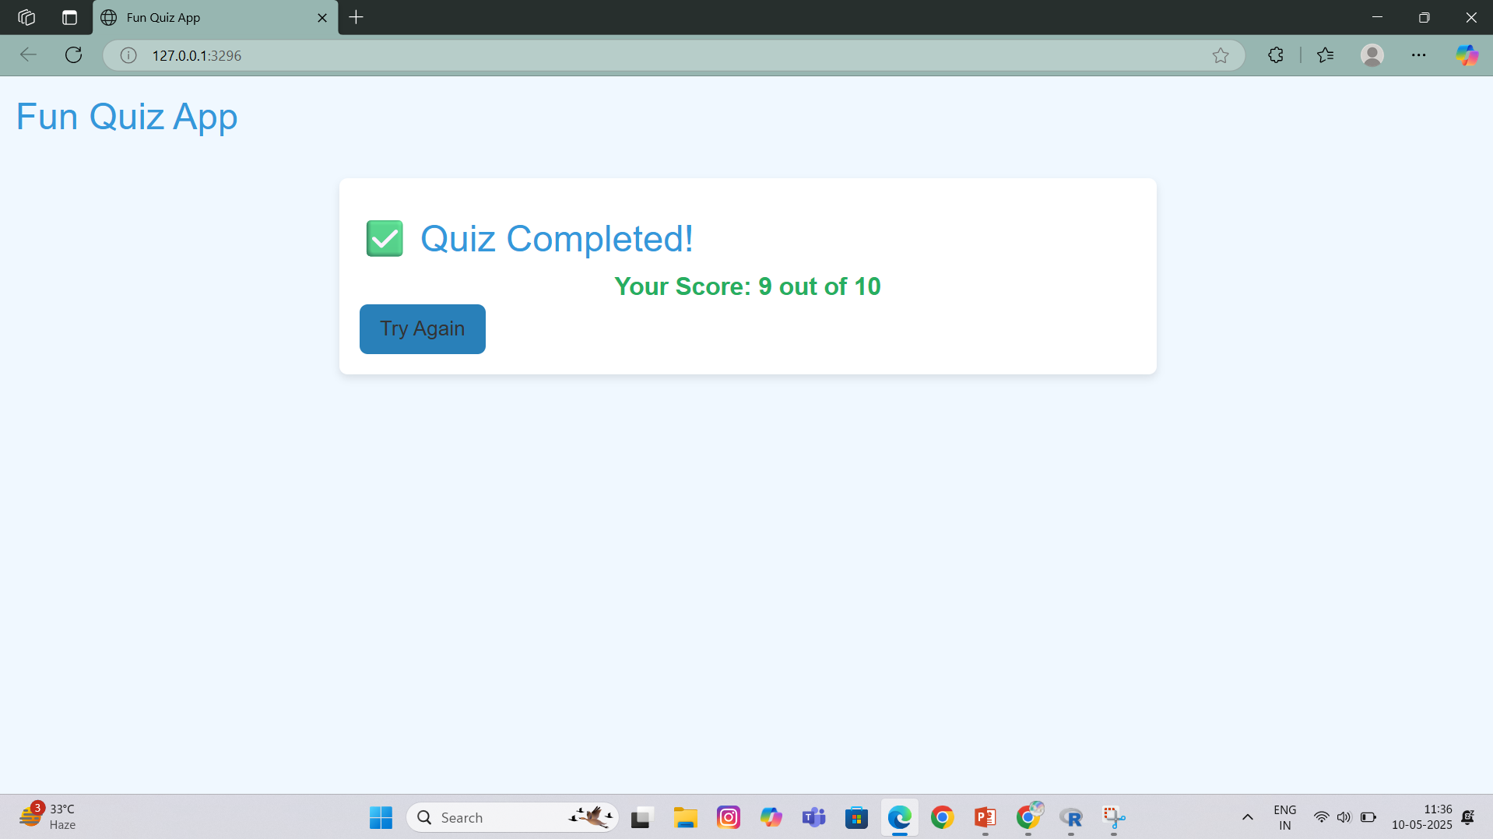
IMPLEMENTATION SCREENSHOTS

Slide 12
CONCLUSION
The Fun Quiz App is an interactive learning tool developed using R and Shiny, designed to make quizzes engaging, dynamic, and educational. It integrates essential modules such as user interface, question management, real-time evaluation, score tracking, and feedback display. This application enhances the learning experience by offering immediate results, easy customization, and a user-friendly platform for both learners and educators.

Slide 13


